Slide 1


AWS SOLUTIONS ARCHITECT ASSOCIATE
Module 3:
Amazon Elastic Compute

Slide 2
Module Overview
Amazon Elastic Compute Cloud (Amazon EC2)
Amazon Elastic Block Store (Amazon EBS)

Slide 3

Lesson 01: Amazon Elastic Compute Cloud (Amazon EC2)

Slide 4
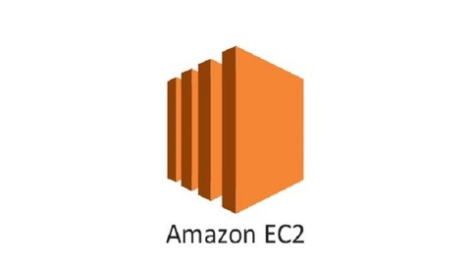
Amazon Elastic Compute Cloud (Amazon EC2)
Compute Basics
Securely Using an Instance
The Lifecycle of Instances
Options
Instance Stores

Slide 5
Amazon Elastic Compute Cloud (Amazon EC2)
Compute Basics
  Instance Types
    Virtual CPUs (vCPUs)
    Memory
    Storage (size and type)
    Network performance
  Instance Families
    c4, Computer Optimized
    r3, Memory Optimized
    i2, Storage Optimized
    g2, GPU based-instances

Slide 6
Amazon Elastic Compute Cloud (Amazon EC2)
Compute Basics
  Amazon Machine Images
    Published by AWS
    The AWS Marketplace
    Generated from Existing Instances
    Uploaded Virtual Servers

Slide 7
Amazon Elastic Compute Cloud (Amazon EC2)
Securely Using an Instance
  Addressing an Instance
    Public Domain Name System (DNS)
    Public IP
    Elastic IP
  Initial Access
  Virtual Firewall Protection

Slide 8
Amazon Elastic Compute Cloud (Amazon EC2)
The Lifecycle of Instances
  Launching
  Managing Instances
  Monitoring Instances
  Modifying an Instance
  Termination Protection

Slide 9
Amazon Elastic Compute Cloud (Amazon EC2)
Options
  Pricing Options
  On-Demand Instances
  Reserved Instances
  Spot Instances
  Tenancy Options
  Shared Tenancy
  Dedicated Instances
  Dedicated Host
  Placement Groups

Slide 10
Amazon Elastic Compute Cloud (Amazon EC2)
Instance Stores

Slide 11
Lesson 02: Amazon Elastic Block Store (Amazon EBS)

Slide 12

Amazon Elastic Block Store (Amazon EBS)
Elastic Block Store Basics
Types of Amazon EBS Volumes
Protecting Data

Slide 13
Amazon Elastic Block Store (Amazon EBS)
Elastic Block Store Basics
Types of Amazon EBS Volumes
  Magnetic Volumes
  General-Purpose SSD
  Provisioned IOPS SSD
  Amazon EBS-Optimized Instances

Slide 14
Amazon Elastic Block Store (Amazon EBS)
Types of Amazon EBS Volumes
Characteristic | General-Purpose SSD | Provisioned IOPS SSD | Magnetic
Use cases | System boot volumes Virtual desktops Small-to-medium sized databases Development and test environments | Critical business applications that require sustained IOPS performance or more than 10,000 IOPS or 160MB of throughput per Volume Large database Workloads | Cold workloads where data is infrequently Accessed Scenarios where the lowest storage cost is important
Volume size | 1 GiB–16TiB | 4 GiB–16TiB | 1 GiB–1TiB
Maximum throughput | 160MB | 320MB | 40–90MB
IOPS performance | Baseline performance of 3 IOPS/GiB (up to 10,000 IOPS) with the ability to burst to 3,000 IOPS for volumes under 1,000 GiB | Consistently performs at provisioned level, up to 20,000 IOPS maximum | Averages 100 IOPS, with the ability to burst to hundreds of IOPS

Slide 15
Amazon Elastic Block Store (Amazon EBS)
Protecting Data
  Backup/Recovery (Snapshots)
    Taking Snapshots
    Creating a Volume from a Snapshot
  Recovering Volumes
  Encryption Options

Slide 16
Lab Module 3

